Slide 1
CH2PH2:
Chemical Kinetics
Dr. James Hallett
j.e.hallett@reading.ac.uk

Slide 2
Lecture 4
CH2PH2 Chemical Kinetics

Slide 3
feedback loops

Slide 4
Why do these reach steady-state?
Negative feedback gives stability (“stable equilibrium”)
Eg: ball at the bottom of a valley: The further away the ball is from the centre, the greater the force pushing it back

Slide 5
Neutrally stable:
Zero feedback gives “neutral equilibrium”
Eg: “ball on flat ground“ – no restoring force; move it to the right – it stays there.

Slide 6
Unstable
Positive feedback gives instability (things that make themselves worse)
Eg: ball on top of a hill – no restoring force; move it to the right – the slope pushes it even further.

Slide 7
Steady-state? Or explosion?
Steady-state goes with negative feedback.
Eg
Lecture 2: d[I]/dt = k₁[A] – k₂[I]
  The more [I], the faster it disappears.
In chain reactions, termination steps provide negative feedback

Slide 8
Positive feedback can cause explosions
  Eg d[I]/dt = ….. +k₂[I]
  The more [I], the faster it appears

Slide 9
Why do these systems reach steady-state?
Negative feedback gives stability (“stable equilibrium”) e.g. d[I]/dt = k₁[A] – k₂[I]
Faster consumption of I / faster acceleration back to the middle
Higher concentration /
Larger displacement from the middle

Slide 10
Neutrally stable:
Zero feedback gives “neutral equilibrium”, e.g. d[I]/dt = k₁[A] – k₂[I]
No change in consumption / no acceleration to the left or right
Higher concentration /
Larger displacement from the origin

Slide 11
Unstable
Positive feedback gives instability (things that make themselves worse) e.g. d[I]/dt = k₁[A] + k₂[I]
Faster production of I / faster acceleration away from the middle
Higher concentration /
Larger displacement from the middle

Slide 12
branching chain reactions
CH2PH2 Chemical Kinetics

Slide 13
Branching chain reactions
In some chain reactions, propagation involves a branching step.
This means that two chain carriers are produced from one
Now, the more chain carriers there are, the faster they are produced.
Branching propagation steps provide positive feedback

Slide 14
Example 1
Consider a non-branching chain reaction.
The chain carrier is R.
M → R (initiation) Rate constant k_{init}
A + R → B + R (propagation) Rate constant k_{prop}
R → disappears (termination) Rate constant k_{term}
Ignoring details of the chemistry, find an expression for d[R]/dt
Is this positive or negative feedback?

Slide 15
Example 1
Consider a non-branching chain reaction.
The chain carrier is R.
M → R (initiation) Rate constant k_{init}
A + R → B + R (propagation) Rate constant k_{prop}
R → disappears (termination) Rate constant k_{term}
Ignoring details of the chemistry, find an expression for d[R]/dt = k_{init}[M] - k_{prop}[A][R] + k_{prop}[A][R] - k_{term}[R]
= k_{init}[M] - k_{term}[R]
Is this positive or negative feedback?
Negative feedback, since -k_{term}[R] term

Slide 16
Example 2
Consider a branching chain reaction.
If there’s no termination step:
  (Again, the chain carrier is R.)
A + R → 2R + B Rate constant k_{prop}
What is d[R]/dt?
Is this positive or negative feedback?

Slide 17
Example 2
Consider a branching chain reaction.
If there’s no termination step:
  (Again, the chain carrier is R.)
A + R → 2R + B Rate constant k_{prop}
What is d[R]/dt?
d[R]/dt = -k_{prop}[A][R] + 2k_{prop}[A][R] = +k_{prop}[A][R]
Is this positive or negative feedback?
Positive, since +k_{prop}[A][R] term

Slide 18
Exponential decay vs exponential increase
d[R]/dt varies with -k[R]
d[R]/dt varies with +k[R]
[R] ∝ C + e^{-kt}
eg “multiply by 0.9 every second”
[R] ∝ e^{kt}
eg “multiply by 1.1 every second”
[R]
Exponential
decay
Exponential
growth
Stable
time
Unstable
time
The “+C” is if there is an initiation step: see later

Slide 19
With branching propagation steps and termination steps
M → R (initiation) Rate constant k_{init}
A + R → 2R + B (propagation) Rate constant k_{prop}
R → disappears (termination) Rate constant k_{term}
d[R]/dt = k_{init}[M] + k_{prop}[A][R] – k_{term}[R]
= k_{init}[M] + (k_{prop}[A] – k_{term}) [R]
Is k_{prop}[A] larger or smaller than k_{term}?
In general, if d[R]/dt = …+ f[R] – g[R]
f-g > 0 Positive feedback Explosion
f-g < 0 Negative feedback Exponential decay

Slide 20
Initiation steps and [R]
Initiation steps don’t depend on [R] and so appear as constants (no feedback)
In cases where negative feedback dominates, adding an initiation step means:
  [R] approaches a constant steady-state value
  may initially increase or decrease
[R]
[R]
time
time

Slide 21
Example:
A → R Rate constant k₁
R + B → 2R Rate constant k₂
R + C → D Rate constant k₃
The rate constants for this reaction scheme are
k₁ = 0.5 s⁻¹
k₂ = 2 M⁻¹s⁻¹
k₃ = 3 M⁻¹s⁻¹
The concentrations of R, A, B and C at a given point in the reaction (t₀) are as follows:
[A]₀ | 1 M
[B]₀ | 10 M
[C]₀ | 5 M
[R]₀ | 1 mM
Sketch a graph of how [R] changes with time after t₀

Slide 22
Example:
A → R Rate constant k₁
R + B → 2R Rate constant k₂
R + C → D Rate constant k₃
The rate constants for this reaction scheme are
k₁ = 0.5 s⁻¹
k₂ = 2 M⁻¹s⁻¹
k₃ = 3 M⁻¹s⁻¹
The concentrations of R, A, B and C at a given point in the reaction (t₀) are as follows:
[A]₀ | 1 M
[B]₀ | 5 M
[C]₀ | 10 M
[R]₀ | 50 mM
Sketch a graph of how [R] changes with time after t₀

Slide 23
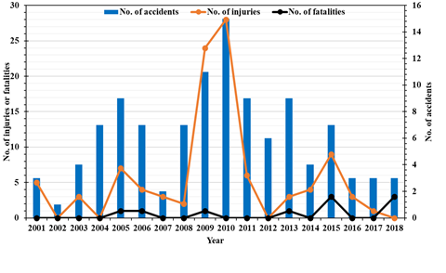
Scale up – consider the kinetics!
“those explosions and the 2008 Sangji case at UCLA were all the result of a failure to scale-up reactions properly.”
(trigger warning) https://www.chemistryworld.com/news/china-grapples-with-lab-safety-following-huge-growth-in-student-numbers/4015486.article

Slide 24
Case study: Nuclear fission
CH2PH2 Chemical Kinetics

Slide 25
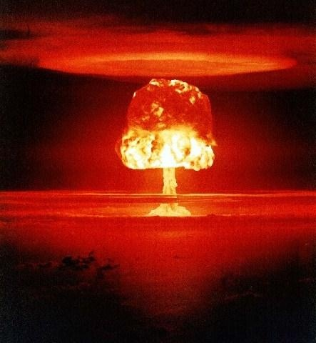
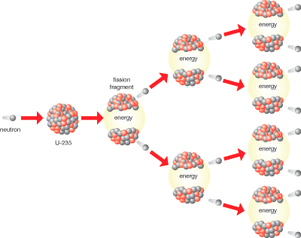
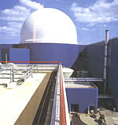
(Case study) Nuclear fission
The chain carrier is a neutron (rather than a radical)
U-235
nucleus
Neutron

Slide 26
Facts about nuclear fission
The reaction only works with a radioactive isotope of Uranium, U-235.
Naturally-occurring Uranium is a mixture of U-235 and U-238, typically <1% U-235.
The reaction requires a higher concentration of U-235 (“enriched”; around 10% for reactors in Europe; >90% for “weapons-grade” (for bombs).
The reaction requires a “critical mass” of material.
Scientists keep nuclear reactors under control

Slide 27
The kinetics of nuclear fission
Assume the initiation step is some spontaneous process:
X → X’ + n (0)
The single branching propagation step is as follows:
n + ²³⁵U → fission fragments + 2½ n (1)
There are various termination steps, including
n → escapes through wall to outside (2)
And, if a neutron-absorbing material such as cadmium or boron is added,
n → absorbed (3)
k_{initiation}
k_{fission}
k_{escape}
k_{absorbed}

Slide 28
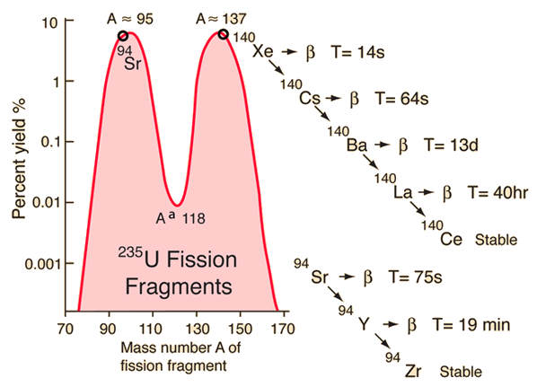
Decay products
hyperphysics

Slide 29
Overall
  d[n] / dt
  =Rate₀ + (2.5 – 1) Rate₁ – Rate₂ – Rate₃
  = k_{initiation}[X] + 1.5 k_{fission}[n] [²³⁵U] - k_{escape} [n]- k_{absorb} [n]
  = k_{initiation}[X] +(1.5 k_{fission}[²³⁵U] – k_{escape} – k_{absorb} )[n]

Slide 30
Worked example
Write this equation in the form
d[R]/dt = C + f[R] – g[R]
where the chain carrier R in this case is our neutron, n.
What are the expressions for f and g? Under what conditions will there be positive / negative feedback?

Slide 31
Worked example: Answer
Write this equation in the form
d[R]/dt = C + f[R] – g[R]
where the chain carrier R in this case is our neutron, n.
d[n]/dt = k_{init}[X] + 1.5k_{fiss}[U][n] – (k_{esc}+k_{abs})[n]

Slide 32
Example Task: Answer
What are the expressions for f and g?
d[n]/dt = k_{init}[X] + 1.5k_{fiss}[U][n] – (k_{esc}+k_{abs})[n]
Under what conditions will there be:
positive feedback?
negative feedback?
f
g

Slide 33
Example Task: Answer
What are the expressions for f and g?
d[n]/dt = k_{init}[X] + 1.5k_{fiss}[U][n] – (k_{esc}+k_{abs})[n]
Under what conditions will there be:
positive feedback? f > g
negative feedback? f < g
f
g

Slide 34
If (1.5 k_{fission}[²³⁵U] – k_{escape} – k_{absorb} ) > 0
        positive feedback;
        unstable
If (1.5 k_{fission}[²³⁵U] – k_{escape} – k_{absorb} ) < 0
        negative feedback;
        Dies away as no further initiation
If (1.5 k_{fission}[²³⁵U] – k_{escape} – k_{absorb} ) = 0
        no feedback, but can get controlled nuclear reaction.
In this last case, k_{escape} and k_{absorb} are effectively using up 1½ of the 2½ neutrons produced by the fission, leaving 1. (So overall, no change in numbers of neutrons)

Slide 35
Nuclear bomb: (1.5 k_{fission}[²³⁵U]) >>(k_{escape} + k_{absorb} )
Nuclear reactor: (1.5 k_{fission}[²³⁵U]) - (k_{escape} + k_{absorb} )≈0
k_{fission} is a constant. Whether or not a stable reaction (or explosion) takes place depends on [U₂₃₅], k_{escape} and k_{absorb}

Slide 36
Is (1.5 k_{fission}[²³⁵U]) < or > (k_{escape} + k_{absorb} ) ?
a) Critical mass:
k_{escape} depends on surface area / volume ratio.
This increases with smaller volume.
(v ∝ r³ A ∝ r² A/v ∝ 1/r)
If the volume is too small, k_{escape} becomes greater than (1.5 k_{fission}[²³⁵U]).
The nuclear reaction cannot be sustained.

Slide 37
Is (1.5 k_{fission}[²³⁵U]) < or > (k_{escape} + k_{absorb} ) ?
b) Uranium enrichment
Even with >90% ²³⁵U a critical mass of ~15kg is required.
With less enriched Uranium, k_{fission}[²³⁵U] becomes smaller, and a greater critical mass is needed (>1 tonne for a nuclear reactor).

Slide 38
Is (1.5 k_{fission}[²³⁵U]) < or > (k_{escape} + k_{absorb} ) ? (ctd)
Control rods
c) Absorption
A nuclear reactor is run at around
  1.5 k_{fission}[²³⁵U]) - (k_{escape} + k_{absorb} )≈0
It is kept at this value by controlling k_{absorb} using “control rods” (cadmium or boron) that absorb neutrons, and which may be lowered or raised in or out of the Uranium.
Scientists have built their own automated “negative feedback” system which raises the rods (decreasing k_{absorb} ) if the reaction begins to die away, and vice versa.
Uranium

Slide 39
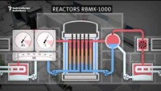
Control Rod Failure
https://youtu.be/f5ptI6Pi3GA?t=50

Slide 40
Learning Outcomes
Today we have:
Described different feedback mechanisms
Introduced branching chain reactions
Understood how different feedback mechanisms lead to different outcomes in chain reactions
Described the archetypal branching chain reaction, and mechanisms to guide the reaction along a desirable path.

